Slide 1
Update on the Development of the Literacy Performance Assessment (LPA) and Pilot Study
Agenda Item 5B
Notes:
Amy

Slide 2
Overview
•Part I: Summary of the LPA Pilot Development
•Part II: Methodology of the LPA Pilot Study
•Part III: LPA Spring 2024 Pilot Study Analysis
•Part IV: Quantitative Findings
•Part V: Qualitative Findings
•Part VI: Literacy Design Team Findings and Next Steps
Notes:
Amy
Reference Appendices A-M

Slide 3
Part I: Summary of LPA Development
Notes:
Heather

Slide 4
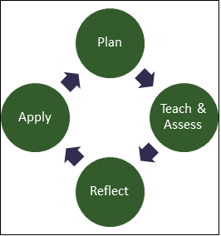
Overview of the LPA
Notes:
Heather

Slide 5
LPA Pilot Rubric Essential Questions
Step 1: Plan
Rubric 2.1 How does the candidate’s learning segment plan build on students’ assets, plan for a variety of assessments, align lessons to create a progression of learning, and address standard(s)-based ELA/Literacy and ELD goals that are grade-level specific and developmentally appropriate?
Rubric 2.2 How does the candidate apply findings from recent literacy assessments (e.g., screenings, literacy and/or language profiles, information provided by their cooperating teacher, student work samples, their observations of students) to plan for: foundational reading skills using a direct, systematic, and explicit approach to support students’ literacy and language development? additional themes from the ELA/ELD Framework using integrated ELD, if appropriate, to support students’ literacy and language development?
Notes:
Heather
Tied to specific TPEs
Starting at level 3- goal for the candidate- move up and down the rubric

Slide 6
LPA Pilot Rubric Essential Questions:
Step 2: Teach and Assess
Step 2: Teach and Assess
Rubric 2.3 How does the candidate teach selected foundational reading skills using a direct, systematic, and explicit approach to actively engage students in progressing toward meeting the ELA/Literacy and ELD goals?
Rubric 2.4 How does the candidate provide instruction in additional themes in the ELA/ELD Framework and, if appropriate, use integrated ELD, to actively engage students in progressing toward meeting the ELA/Literacy and ELD goals?
Rubric 2.5 How does the candidate use formative assessment to monitor student learning and adjust instruction to support students in progressing toward meeting the ELA/Literacy and ELD goals?
Rubric 2.6 How does the candidate use results of assessments to provide feedback to students about what they did well, where there were misconceptions or gaps in knowledge, and/or what students need to do next to continue progress toward and/or beyond the ELA/Literacy and ELD goals?
Notes:
Heather

Slide 7
LPA Pilot Rubric Essential Questions: Step 3: Reflect and Step 4: Apply
Step 3: Reflect
Rubric 2.7 How does the candidate analyze the summative assessment results based on the performance criteria, identify learning patterns and/or trends, and determine what was effective and what instructional changes they would make to their approach(es) for literacy instruction?
Step 4: Apply
Rubric 2.8 How does the candidate apply the analysis of student assessment results (formative and summative) to plan and teach a follow-up activity and provide a rationale, citing evidence from Steps 2 and/or 3?
Notes:
Heather

Slide 8
Part II: Candidate Participation: Credential Area, Pathway, Sector, and Ethnicity
Notes:
Amy

Slide 9
Number of Candidates by Credential Area
Credential Area | N Candidates
MS- TK-3 | 58
MS- 4-8 | 27
EdSp- MMSN | 66
EdSp- ESN | 43
EdSp- ECSE | 22
EdSp- DHH | 2
EdSp- VI | 2
Total | 219
Notes:
Amy

Slide 10
Number of Candidates by Pathway
Pathway Type | N
University Student Teaching Program (Traditional 5th Year) | 82
District Intern | 59
University Intern | 33
Residency Program | 19
Integrated Undergraduate Teacher Credentialing Program (ITEP) | 15
University Private School Program (Traditional 5th Year) | 11
Total | 219
Notes:
Amy

Slide 11
Pathway by Credential Area
Notes:
Amy

Slide 12
Number of Candidates by Sector
Sector Type | N
CSU | 116
Private/Independent | 71
LEA/County Office of Education | 32
UC | 0
Total | 219
Notes:
Amy

Slide 13
Number of Candidates by Ethnicity
Ethnicity | N Submitted
White (non-Hispanic) | 85
Mexican American/Chicano | 67
Latino/Latin American/Puerto Rican/Other Hispanic | 31
African American/Black | 15
Filipino American/Filipino | 4
Other | 4
Chinese American/Chinese | 3
Native American/American Indian/Alaskan Native | 3
Choose not to response | 2
Asian Indian American/Asian Indian | 1
Japanese American/Japanese | 1
Laotian American/Laotian | 1
Other Southeast Asian American/Southeast Asian (e.g., Hmong, Khmer) | 1
Vietnamese American/Vietnamese | 1
Total | 219
Notes:
Amy

Slide 14
LPA Pilot Assessor Recruitment, Training, and Scoring
Spring 2024 Pilot Study Methodology
Notes:
Amy

Slide 15
LPA Pilot Assessors
Credential Area | Assessors | Submissions Scored
MS (TK-3) | 13 | 58
MS (4-8) | 25 | 27
MMSN | 18 | 66
ESN | 8 | 42
ECSE | 7 | 22
DHH | 6 | 2
VI | 2 | 2
Total | 79 | 218*
* 219 submissions were received. One submission was unscorable due to missing evidence.
Notes:
Amy

Slide 16
Part III: LPA Pilot Study Analysis: Scores, Surveys and Focus Groups
Notes:
Heather

Slide 17
Key Findings
•Focusing on one student was an effective strategy that enabled candidates to understand the student’s literacy learning needs and how to provide more targeted support and understand the learning needs of their focus student.
•The instructions for using ELA/Literacy standards and the ELA/ELD Framework were clear, but some found the Framework complex and suggested simplified explanations for better understanding of how to use these documents while completing the LPA.
•Program coordinators and assessors suggested more clearly defining “direct, systematic, and explicit” and providing examples to help candidates understand these approaches.
•Candidates were able to identify students’ assets, cultures, languages, dialects, and/or home communities in their explanation of the group of students they were teaching, however, candidates were challenged to bring this information into their instructional activities and assessments. A prompt should be added the Learning Segment template to support candidates in this area.
•Candidates should continue to provide ELD standards and goals regardless of the number of English Learners in their class.
Notes:
Heather

Slide 18
Key Findings, continued
•Candidates and program coordinators appreciated the flexibility in their choices in the LPA to demonstrate their ability to teach literacy (e.g., number of video clips, commentary format).
•Candidates appreciated having multiple means of representing their learning (e.g., commentary, feedback to students).
•Candidates should be required to provide feedback to students that is explicit and related to the ELA/Literacy and ELD learning goals.
•Candidates would benefit from examples of product, process and performance assessments.
•Using one construct in levels 4 and 5 allowed candidates to demonstrate the full range of performance in the rubrics. Assessors were able to find evidence for the constructs in each of the levels.
•Providing mid-range examples (candidate submissions that scored mostly 2s and 3s) would be beneficial to help set clear expectations and provide a common understanding for programs, assessors and candidates.
Notes:
Heather

Slide 19
Part IV: Quantitative Findings- LPA Pilot Study Results: Scoring and Surveys
Notes:
Amy

Slide 20
LPA Pilot Study Quantitative Findings: Scoring
Quantitative Findings- LPA Pilot Study Results: Scoring, Surveys, and Focus Groups
Notes:
Amy

Slide 21
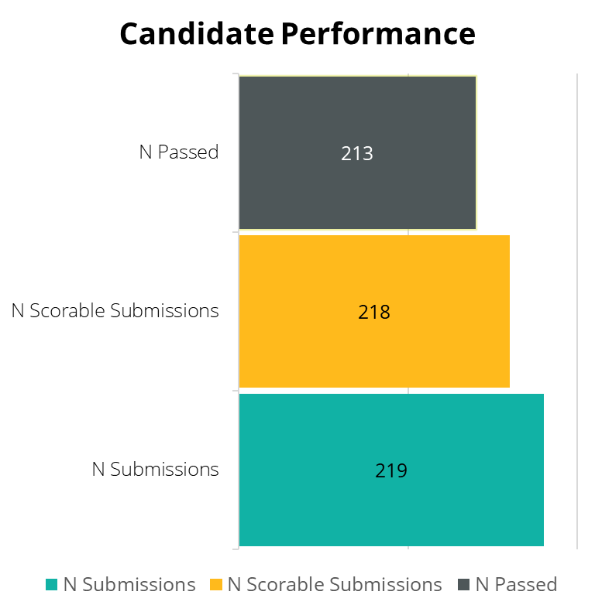
Candidate Performance
Overall Passrate
97% passrate with an overall mean score of 21.1.
Scorable Submissions
Almost 100% scorable submissions (1 unscorable)
Submissions
There were 236 candidates registered (93% of those registered submitted an assessment)
Notes:
Amy
Total candidates does not include voids-
218- includes the 4 nonpassers and the voids
213- includes voids (they had passing scores)

Slide 22
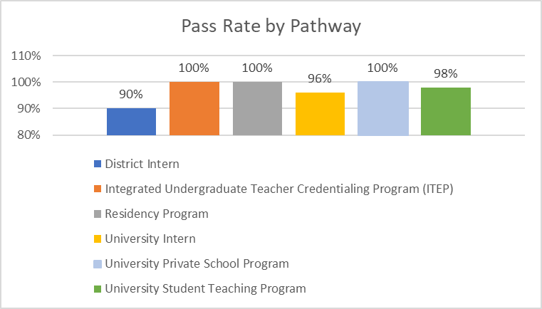
Pass Rate by Pathway
Notes:
Amy

Slide 23
Pass Rate by Ethnicity
Ethnicity | N Submitted | N Passed | N Not Passed
African American/Black | 15 | 14 | 1
Asian Indian American/Asian Indian | 1 | 1 | 0
Chinese American/Chinese | 3 | 3 | 0
Choose not to response | 2 | 2 | 0
Filipino American/Filipino | 4 | 4 | 0
Japanese American/Japanese | 1 | 1 | 0
Laotian American/Laotian | 1 | 1 | 0
Latino/Latin American/Puerto Rican/Other Hispanic | 31 | 31 | 0
Mexican American/Chicano | 67 | 65 | 2
Native American/American Indian/Alaskan Native | 3 | 3 | 0
Other | 4 | 4 | 0
Other Southeast Asian American/Southeast Asian (e.g., Hmong, Khmer) | 1 | 1 | 0
Vietnamese American/Vietnamese | 1 | 1 | 0
White (non-Hispanic) | 85 | 83 | 2
Total | 219* | 213 | 5
* 219 submissions were received. One submission was unscorable due to missing evidence.
Notes:
Amy
4 did not meet 14 points
1 was not scoreable (missing evidence)

Slide 24
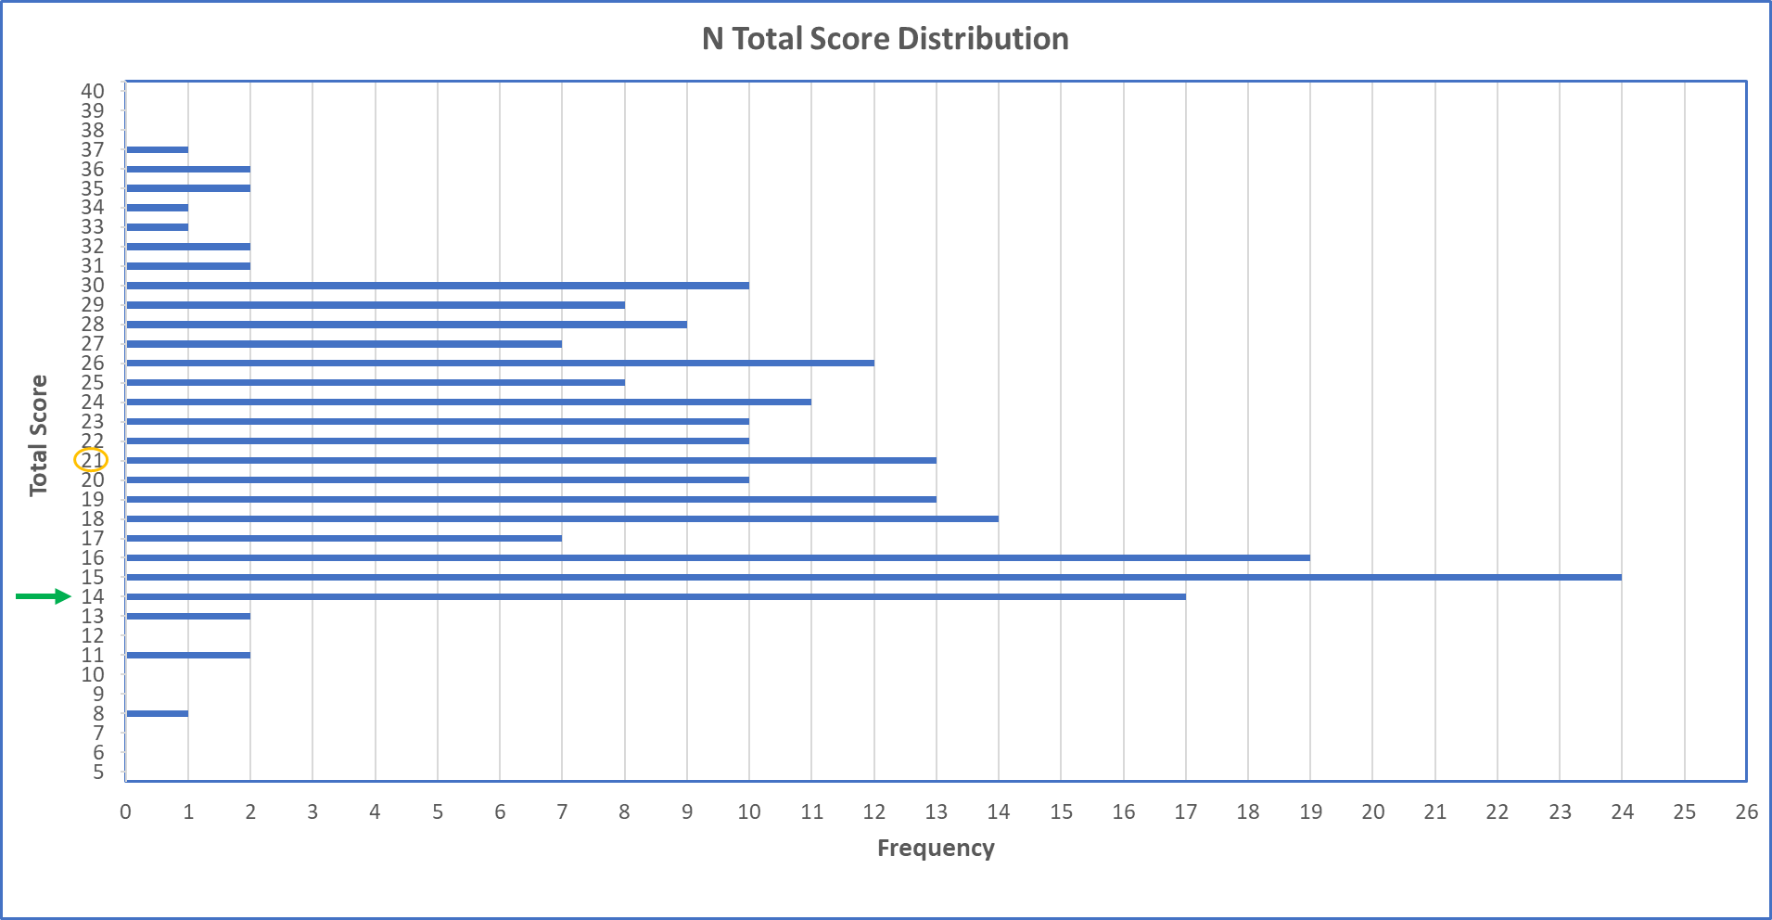
24
Notes:
Amy
5 people scored below 14
81 people scored between 14 and 18 (37%)
132 people scored 19 or above (61%)

Slide 25
Mean Scores by Credential Area
Credential Area | N Candidates | Pass Rate | Overall Mean Score | S.D. | Min | Max
MS- TK-3 | 58 | 98% | 23 | 5.1 | 13 | 33
MS- 4-8 | 27 | 100% | 20 | 5.7 | 14 | 34
EdSp- MMSN | 66 | 97% | 20 | 6.8 | 8 | 37
EdSp- ESN | 42 | 95% | 20 | 6.2 | 13 | 31
EdSp- ECSE | 22 | 100% | 20 | 3.6 | 15 | 27
EdSp- DHH | 2 | 50% | 16 | 6.4 | 11 | 20
EdSp- VI | 2 | 100% | 22 | 1.4 | 21 | 23
Total | 218 | 97% | 21 | 5.9 | 8 | 37
Notes:
Amy
Current passing standards for 9 rubrics
MS-19 (no more than 1 score of 1)
MMSN-17- (no more than 1 score of 1)
ESN-15

Slide 26
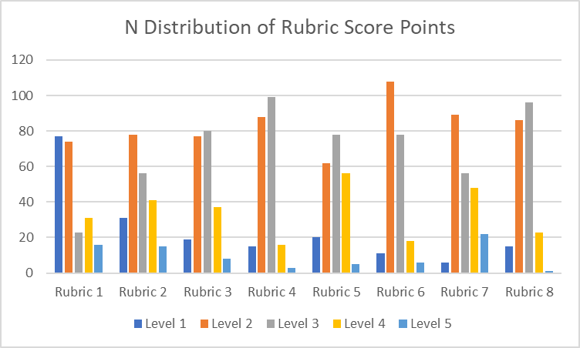
Overall Distribution of Rubric Score Points
Notes:
Amy
Look at this data to make sure our rubrics are functioning and the score is achievable
To see breakout by step-refer to item

Slide 27
LPA Pilot Study Quantitative Findings: Surveys
Quantitative Findings- LPA Pilot Study Results: Scoring, Surveys, and Focus Groups
Notes:
Amy

Slide 28
Survey Categories
Opportunity to Demonstrate Knowledge, Skills, and Abilities
Clarity and Ease of Use
LPA Pilot Information and Support
Notes:
Amy

Slide 29
Opportunity to Demonstrate Knowledge, Skills, and Abilities
Candidates, Program Coordinators, Cooperating Teachers, and Assessors
Notes:
Amy

Slide 30
The LPA allowed candidates to demonstrate their literacy knowledge, skills, and abilities in an authentic way
Program Coordinators, N=16
Cooperating Teachers, N=30
Notes:
Amy

Slide 31
Clarity and Ease of Use
Candidates, Program Coordinators, Cooperating Teachers, and Assessors
Notes:
Amy

Slide 32
The directions for how to identify my focus student were clear.
Candidates, N=78
Program Coordinators, N=16
Notes:
Amy

Slide 33
Focusing on one student made it easier for me to understand the student’s literacy learning needs.
Candidates, N=78
Program Coordinators, N=16
Notes:
Amy

Slide 34
Cooperating Teachers, N=30
Focusing on one student made it easier for my candidate to understand their literacy learning needs.
Notes:
Amy

Slide 35
The directions for how to plan for English Language Development (ELD) were clear.
Candidates, N=78
Program Coordinators, N=16
Notes:
Amy

Slide 36
The directions for how to provide students with feedback from the summative assessment were clear.
Candidates, N=78
Program Coordinators, N=16
Notes:
Heather

Slide 37
The way the LPA guide was organized made it easy to find the information I needed (e.g., rubrics embedded with step instructions, glossary, links to resources).
Program Coordinators, N=16
Assessors, N=45
Notes:
Amy

Slide 38
Assessors, N=45
The Assessment Guide directions provided in the LPA were clear.
Notes:
Amy

Slide 39
The LPA [Rubric] Essential Questions were clear.
Program Coordinators, N=16
Assessors, N=45
Notes:
Amy

Slide 40
LPA Pilot Information and Support
Candidates, Program Coordinators, Cooperating Teachers, and Assessors
Notes:
Amy

Slide 41
Program faculty/instructors provided sufficient support during the LPA pilot test
Candidates, N=78
Cooperating Teachers, N=30
Notes:
Amy

Slide 42
Cooperating teachers provided sufficient support during the LPA pilot test.
Candidates, N=78
Program Coordinators, N=16
Notes:
Amy

Slide 43
Cooperating Teachers, N=30
I discussed the LPA materials (Assessment Guide, Templates, and/or Rubrics) with my candidate.
Notes:
Amy

Slide 44
Cooperating Teachers, N=30
I provided support to my candidate to select the ELA/Literacy Standards for their lessons and assessments.
Notes:
Amy

Slide 45
Part V: Qualitative Findings
Notes:
Heather

Slide 46
Focus Group Data and Open-Ended Survey Responses
Candidates, Program Coordinators, Cooperating Teachers, and Assessors
Notes:
Heather

Slide 47
Do you feel that a performance assessment provides a better opportunity to demonstrate your ability to teach reading, writing, listening, and speaking than a multiple-choice exam such as RICA?
Candidate
"I found the LPA to be extremely challenging in applying the knowledge and skills gained from coursework to creating a meaningful literacy lesson that targeted multiple learning needs, assets and strengths so each student had opportunity to engage and make progress towards meeting learning objectives. As challenging as it was, it was equally rewarding in achieving successes and learning from reflection on the effectiveness of the instruction. This was a much more effective way for me to demonstrate my learning of and ability to teach literacy skills to students with diverse needs. Rather than experiencing test anxiety which would have likely impacted my score in negative ways, the LPA gave me time to think, synthesize, utilize resources, and get know real students’ abilities and needs. This provided me with a very meaningful, enriching learning experience in how to effectively teach literacy in an elementary class.”
(Pg. 65)
Notes:
Heather

Slide 48
Do you feel that a performance assessment provides a better opportunity to demonstrate your ability to teach reading, writing, listening, and speaking than a multiple-choice exam such as RICA? (Candidates, continued)
“Agree. Putting your knowledge into practice is the best way to show it. You can tell in a classroom setting what’s going to go well and what's not.”
“I’m glad I did the pilot because I was stressed about having to take RICA. I like the PA because you get to see me ... what I have to offer as a teacher.”
“I am encouraged to see the LPA potentially supplanting the RICA, as it shows that the CTC is looking to implement more effective ways to assess teacher abilities.”
“My experience was great, and I loved how detailed it was and how clear the rubrics were as well as the assessment guide. It helped me know what to expect and do each step to the best of my ability.”
(Pg. 65)
Notes:
Heather

Slide 49
Do you feel that a performance assessment provides a better opportunity to demonstrate your ability to teach reading, writing, listening, and speaking than a multiple-choice exam such as RICA? (Program Coordinators)
Program Coordinator
"It's better for programs. With PA you get rubric-based feedback that allows both candidates and programs to improve. RICA does not do that."
"I love that they actually have to look at the literacy levels before they start to plan. That’s an advantage over RICA. I love that the PA has them apply literacy in the real world."
“Hands down. As someone who has taught a tiered literacy course, for candidates who got freaked out memorizing terms they were able to focus more on showing their understanding of the process than remembering the terms.“
(Pg. 66)
Notes:
Heather

Slide 50
Cooperating Teachers
“The LPA seemed to cover all the bases of what would be beneficial in preparing a new teacher. All the templates were thorough and was a beneficial and practical experience.”
“I felt this LPA pilot was very helpful and beneficial to help teach literacy. Having the student teachers do hands on lessons gave more practical experience as opposed to learning from a book.”
“It was an involved process but extremely meaningful and worthwhile. It aligns with what educators do daily and serves as a process to ensure we are certificating qualified and effective new teachers into the profession.”
“I have mentored several teaching candidates the past few years from different credential programs. I think the LPA was helpful in preparing my current candidate for teaching.”
(Pg. 69-70)
Notes:
Heather

Slide 51
Rubric Use and Support
Candidate
“Yes, I had a whole packet ... I printed them out ... as I was writing I was looking at the rubrics to make sure I addressed all of the [constructs]. I targeted level 3.”
“Before I filled out anything I did read over the rubric and kept it in the back of my mind. After I was done with everything I pulled up the rubric to make sure everything was there and I didn’t miss anything."
"Yes, but it also made it hard because it caused me to [second guess] myself.”
Coordinator
“We coached with sentence framing. We also started having the rubrics being mentioned and used in prior courses, e.g. tiered literacy instruction and tiered math instruction so they’re familiar with checking themselves before engaging in the TPA.”
“As they completed the templates we would go over them using the rubrics. We created a self-assessment rubric that essentially turns the rubrics into questions."
“I helped candidates map rubric criteria to individual prompts in the templates so that they knew where they could provide evidence of each construct.”
(Pg. 70)
Notes:
Heather

Slide 52
Part VI: Literacy Design Team Findings and Next Steps
Notes:
Amy

Slide 53
Literacy Design Team Findings
Step 1: Plan
The terms “direct,” “systematic,” and “explicit” were used by candidates in their submissions, but not always correctly (e.g., interchanged, with a different meaning). Consider separating the terms in the glossary.
It is difficult to observe systematic instruction in 3-5 lessons. Add a prompt related to how the series of 3-5 lessons fits into the larger scope and sequence of the unit of instruction to provide evidence related to systematic instruction.
Using students’ assets, cultures, languages, dialects, and/or home communities in lessons was not understood. Candidates could identify them in Part A, but it was not explicitly asked for in Part B (Learning Segment Template) and a prompt should be added.
Address standards and goals in the writing of the Learning Segment by adding a prompt that asks specifically for the ELA/Literacy standards and the ELD standards that are used to write the learning goals.
Consider a 20–25-page limit for the Learning Segment template.
EdSp candidates should continue to plan for the use of instructional support personnel.
Candidates should continue to provide ELD standards and goals regardless of the number of English Learners in their class. Candidates with English Learners should plan for Integrated EL
(pg. 37)
Notes:
Amy
After reviewing all the data with the LDT, here are select findings. For complete recommendations, see the report on page XX

Slide 54
Literacy Design Team Findings- Step 2: Teach and Assess
Step 2: Teach and Assess
Candidates often use “good job” as feedback, which is not actionable. Consider adding “actionable” to Rubric 2.6
In Rubric 2.5 (EdSp only) requiring the instructional support personnel to appear in the video should be reconsidered due to filming permissions, staffing, and explanations from candidates regarding the use of personnel in other classrooms.
Misinformation provided by the candidate during instruction was discussed to be addressed within the rubrics. Consider scoring a candidate a 1 or applying a condition code if there are consistent and deep misunderstandings of ELA/ELD framework or the misinformation impacts ability of students to learn. Consensus was not reached around addressing this in the rubrics or through a condition code.
(Pg. 37-38)
Notes:
Amy

Slide 55
Literacy Design Team Findings- continued
Step 3: Reflect
Candidates should be required to provide feedback to students that is explicit. Consider providing models.
Candidates would benefit from examples of product, process and performance assessments.
Revising the instructions for the submission of the feedback to the focus student and providing examples would assist candidates.
Step 4: Apply
Address the recent literacy assessments candidates used to plan their learning segments to make a connection in the final step.
(Pg. 38)
Notes:
Amy

Slide 56
Changes for the Field Test
Notes:
Amy

Slide 57
LPA Revisions for Field Test
Add page limits for Parts A-K
Revisit the requirement to see the instructional support personnel in the video clip(s) in the EdSp versions
Address inaccuracies in lesson delivery within the rubrics
Provide examples of student processes, products, or performances to showcase the variety of assessment types that can be selected by candidates for the LPA.
Add the option to provide video commentary in Step 4.
Continue to copy edit and identify terms to add to the glossary
  Consider how to clarify “direct, systematic and explicit”
  Learning Segment template will be reformatted and revised to address:
    ways in which candidates include practices that build on the diversity of students’ assets, cultures, languages, dialects, and/or home communities.
    a section for candidates to reference ELA/Literacy and ELD standards and the larger scope and sequence that their lessons fit into to demonstrate systematic instruction.
Continue to check for alignment of evidence required in each rubric and the related assessment prompts
Notes:
Amy
Step by Step in the item, high level here

Slide 58
LPA Revisions for Field Test- continued
Review and revise all rubrics as needed to align with and any changes.
Provide access to candidate mid-range responses post-field test.
Discuss strategies with ES for how rubric-level score reports can be shared with candidates and programs to clarify what candidates need to address to advance their literacy instruction.
Continue to work with candidates, program coordinators, cooperating teachers, and assessors to determine the most effective supports for all groups as teacher preparation programs prepare for the operational assessment in the 25/26 academic year.
Continue to work with the bilingual community to prepare for the LPA field test and the operational assessment in the 25/26 academic year.
Consider what can be done to share data with programs in the Results Analyzer platform by providing specific data reports quarterly and/or bi-annually allowing programs to then apply the rubric level findings to program development, to update syllabi, and or provide needed supports to candidates.
Explore the use of an interactive web-based platform for the candidate assessment guide that will be beta-tested in the LPA field test.
Notes:
Amy

Slide 59
Next Steps in Preparation for the Field Test
  Complete LPA Field test program recruitment
  Finalize LPA Tasks, Rubrics, Program Guides, and Support Materials
  Request LPA Field test candidate waivers
  Determine LPA field test program supports
  Begin LPA Field Test
Notes:
Amy

