Slide 1
The Statewide Residency Technical Assistance Center’s Support of the Teacher Residency Grant Program
December 2024
Maggie Hannan, Jeanna Perry, Kate Hirschboeck, Andrew Brannegan & Melissa White

Slide 2
The Teacher Residency Grant Program (TRGP) & WestEd’s evaluation work
Teacher Residency Grant program (TRGP): $600 million state investment to launch and expand residencies in CA
  Launched in 2018, expanded in 2021 and 2022, funds expected to be encumbered by 2029
  The grant-funded residencies are led by partnerships between local education agencies and colleges or universities (IHEs) and are specifically focused on preparing teachers in high-need shortage areas.
WestEd, in partnership with the CTC, has conducted the formative evaluation for the Teacher Residency Grant program (TRGP) since its launch in 2018.
  Audiences: practitioners, policymakers & funders, technical assistance providers
  Purpose: Intended to provide timely feedback, enabling stakeholders to adjust their work as this initiative evolves.

Slide 3
Through WestEd’s Formative Evaluation of the residencies funded through the initial 2018 legislation, several focal areas have emerged that have informed SRTAC’s work
Residency partnerships needed strengthening. Challenges included a need for:
  Greater LEA and IHE leadership engagement
  Alignment between the residency and LEA's workforce strategy
  Improved staffing and partnership structures
Most programs did not have clear plans in place to sustain their residencies post-grant
Most programs were not offering the level of financial support needed to make residencies an affordable option for candidates
Residency program participation in technical assistance to support affordability, sustainability, and foundational partnership development was uneven.

Slide 4
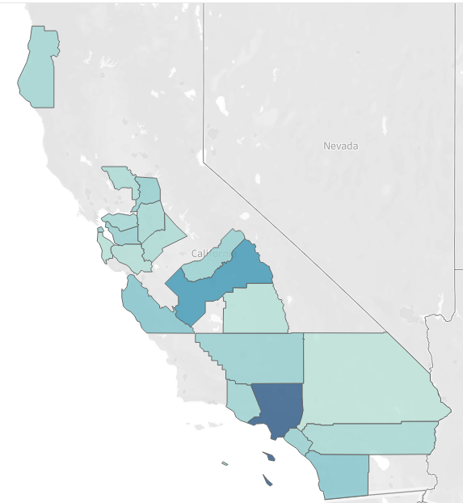

Additionally, over the first four years of the grant, there was uneven uptake across the state.
21 out of 58 counties in the state had TRGP-funded residents during the first four years of the program.
Many counties, particularly in Northern California and along the California-Nevada border had no TRGP-funded partnerships

Slide 5
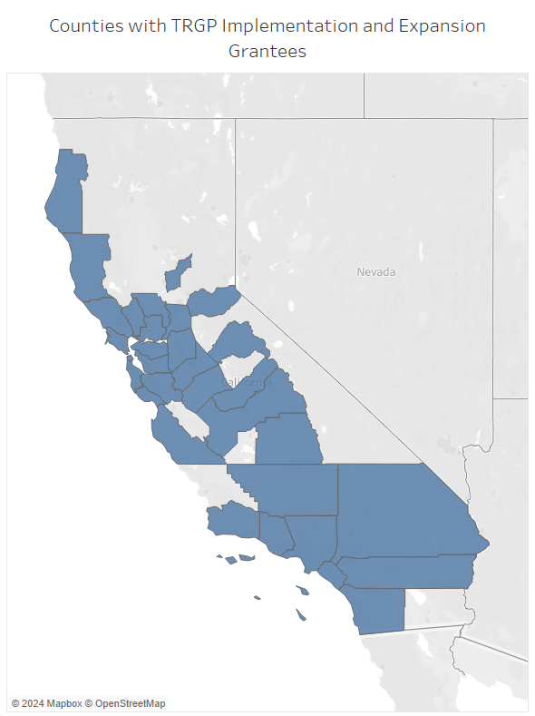
Signs of expanding TRGP uptake from 2023 to 2024

Slide 6
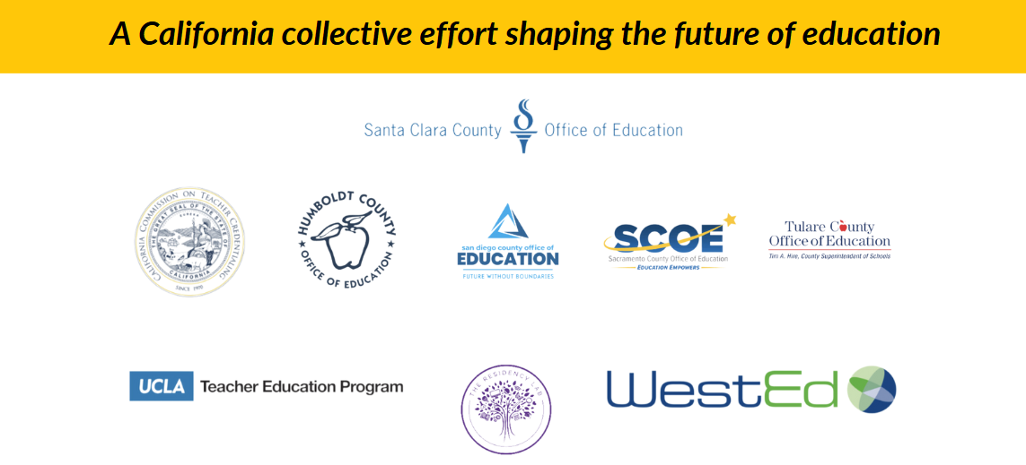
Statewide Residency Technical Assistance Center (SRTAC)

Slide 7



Why We Exist:
SRTAC Mission, Vision, & Goals
Mission
SRTAC provides a coherent statewide infrastructure to support powerful and sustainable educator residency partnerships.
Vision
The Statewide Residency Technical Assistance Center in California envisions a future where every educator preparation program (EPP) is empowered with the technical assistance, tools, and resources needed to cultivate and retain a diverse and highly qualified educator workforce.
Commitment
Foster excellence in educator preparation and retention to ensure that every classroom in California is led by well-prepared educators equipped to meet the needs of our state’s diverse student population.

Slide 8
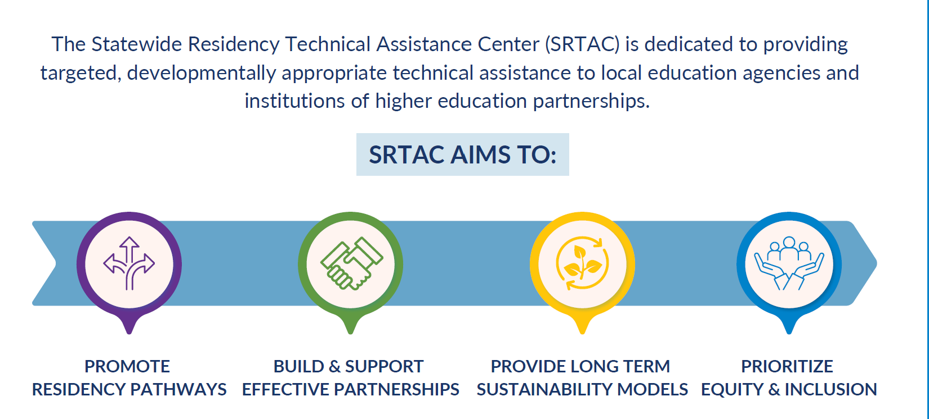
What We Do:
Strategic Direction

Slide 9
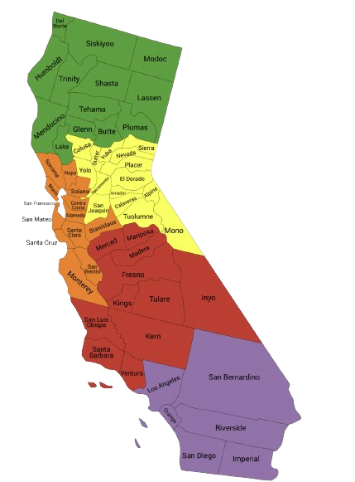
How We Support:
Residency Programs Across the State
Humboldt COE (Northern Hub): Sheila Rocker Heppe srockerheppe@hcoe.org
Sacramento COE (Capital Hub): Tina Tranzor ttranzor@scoe.net
Santa Clara COE (Bay Area Hub): Conni Campbell ccampbell@sccoe.org
Tulare COE (Central Hub): Adriana Cervantes-Gonzalez acgonzalez@tcoe.org
San Diego COE (Southern Hub): Sheiveh Jones snjones@sdcoe.net

Slide 10
Summary: Supports Provided to Teacher Residency Programs by Regional Hubs
 | Grant-funded TR Programs | Locally Funded TR Programs | Prospective TR Programs*
Humboldt COE | 9 | 1 | 19
Sacramento COE | 16 | 0 | 18
San Diego COE | 24 | 5 | 30
Santa Clara COE | 20 | 0 | 8
Tulare COE | 5 | 2 | 2
Totals | 74 | 8 | 77

Slide 11
2023-24 SRTAC Impacts
2023-24 Activities | 22 grant overview sessions with 139 LEA/IHE partners attending the sessions
 | 68 one-on-one LEA coaching sessions
 | 59 region-specific events held to engage and partner with local LEAs and IHEs with a total of 251 LEA/IHE partners attending
 | 12 presentations to education partners, five presentations at professional learning conferences
 | 4 statewide virtual candidate recruitment events with 205 total attendees
 | 2 articles published- an article for CCTE & ACSA that will be released in 2025
 | 45 online resources for use by LEAs to use within their residency programs
 | 3 regional residency site visits (Northern, Central, Southern California) with 107 LEA/IHE Partners in attendance

Slide 12
Looking Ahead: 2024-25 Focus Areas
As SRTAC enters its second year of operation, the work from Year 1 will continue while layering technical assistance to teacher and school counselor residency programs to include topics such as:
  Attracting and retaining diverse cohorts of residents reflective of the communities served.
  Making preparation programs affordable for candidates.
  Becoming sustainable and independent of grant funds or other one-time funding.
  Designing a clinically rich, high-retention preparation route.
  Supporting resident learning through well-prepared and culturally responsive mentors.

Slide 13
2024-25 SRTAC Events
September 9, 2024 | Northern & Capital Regional Kickoff Event: Hosted by Sacramento & Humboldt County Office of Education Southern Regional Kickoff Event: Hosted by San Diego County Office of Education
September 23, 2024 | Bay Area Regional Kickoff Event: Hosted by Santa Clara County Office of Education Central California Regional Kickoff Event: Hosted by Tulare County Office of Education
February 3, 2025 | Northern, Capital, & Bay Area Regional Kickoff Event: Hosted by Santa Clara, Sacramento & Humboldt County Office of Education Southern Regional Kickoff Event: Hosted by San Diego County Office of Education
March 3, 2025 | Central California Regional Kickoff Event: Hosted by Tulare County Office of Education
May 1-2, 2025 | Annual Statewide Symposium

Slide 14
Learn more about SRTAC
Contact Information
Adora Fisher: afisher@sccoe.org
Jeanna Perry: jperry@sccoe.org

